Slide 1


Robust
Multi-Modal
Contrastive Learning
Master Thesis –Final Presentation
Stanislas Furrer
Swiss Mobility Programme
Eidgenössische Technische Hochschule Zürich(ETHZ)
Zurich, Switzerland
Email: sfurrer@student.ethz.ch
03.08.2021
Notes:
So Hi Every One, I’m very happy to present my Master Thesis on our novel Robust Multi-Modal Contrastive Leaning.

Slide 2
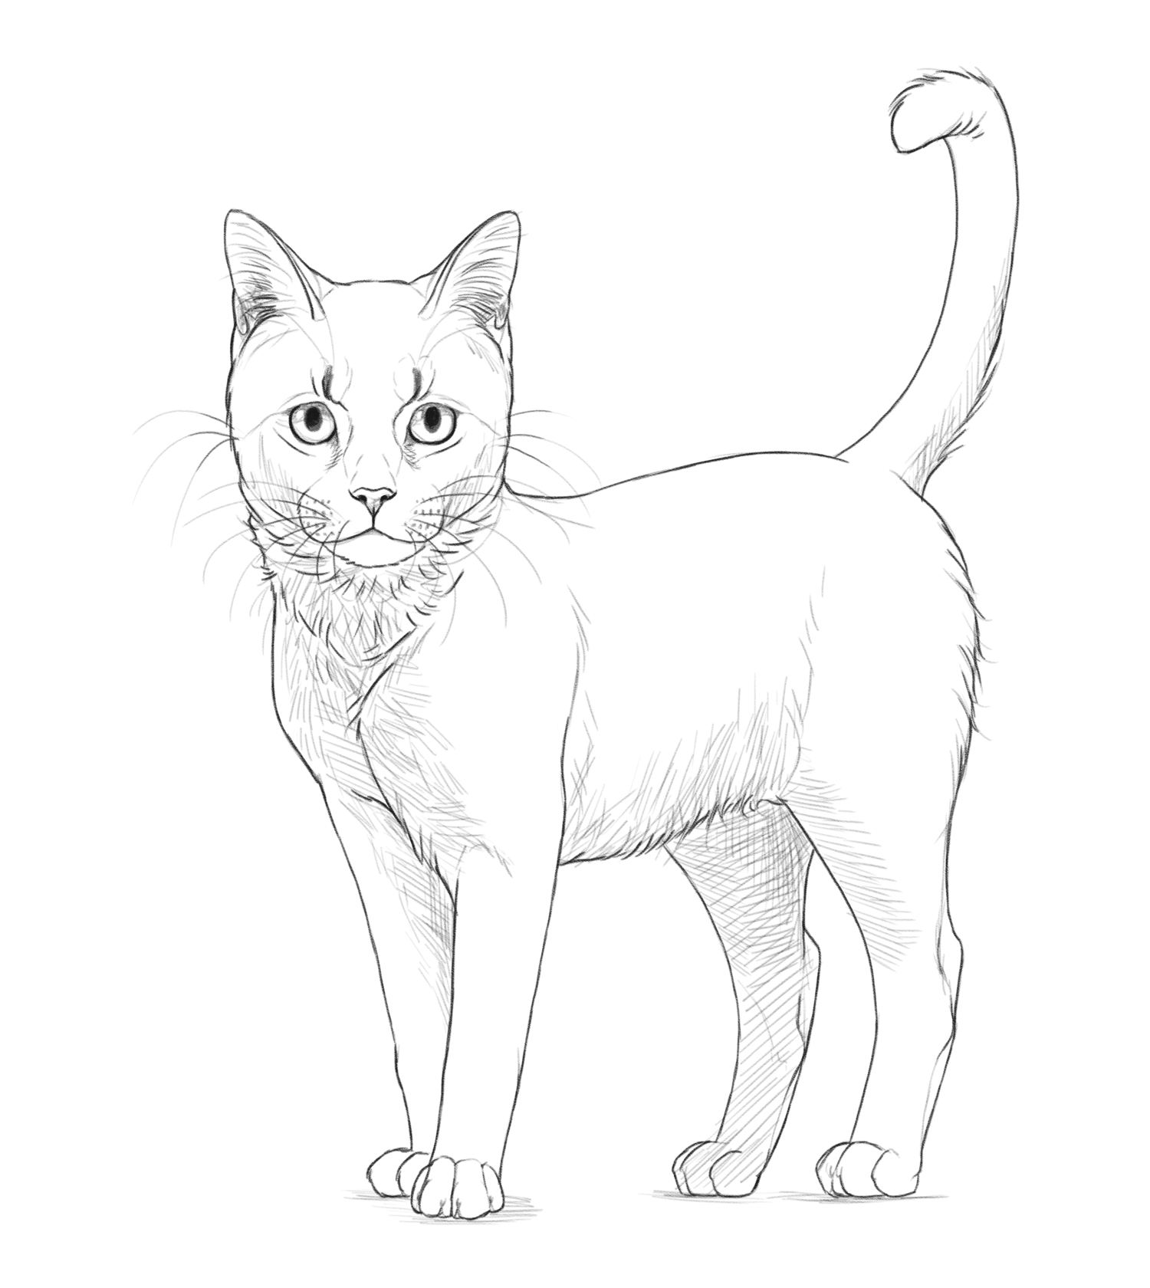
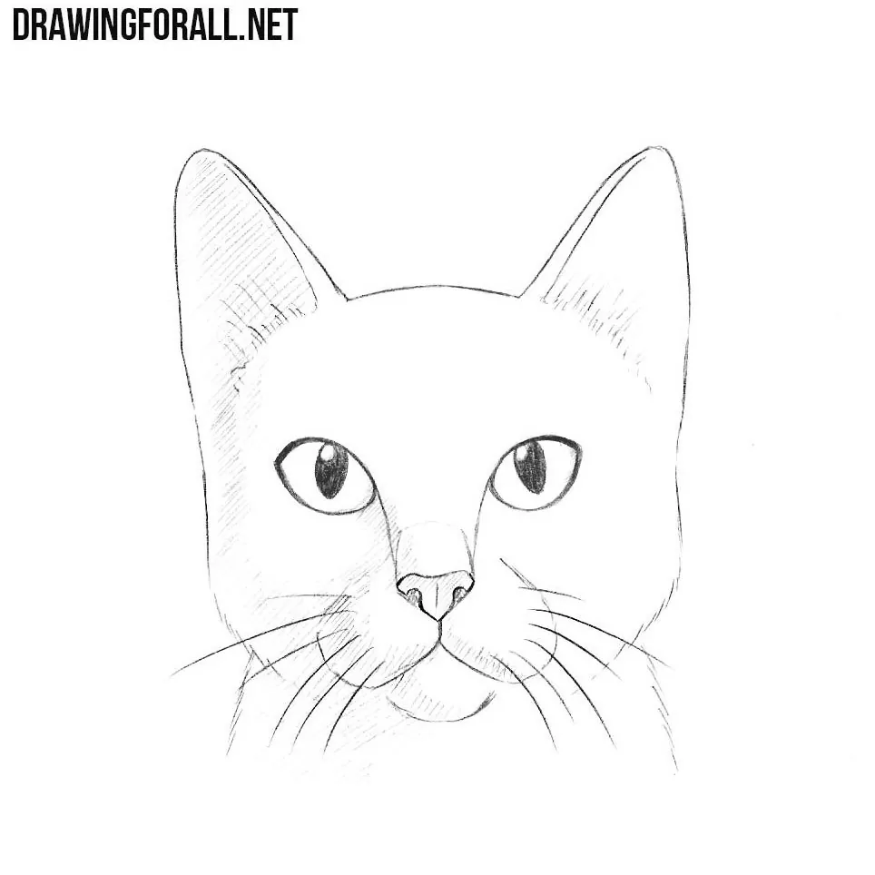
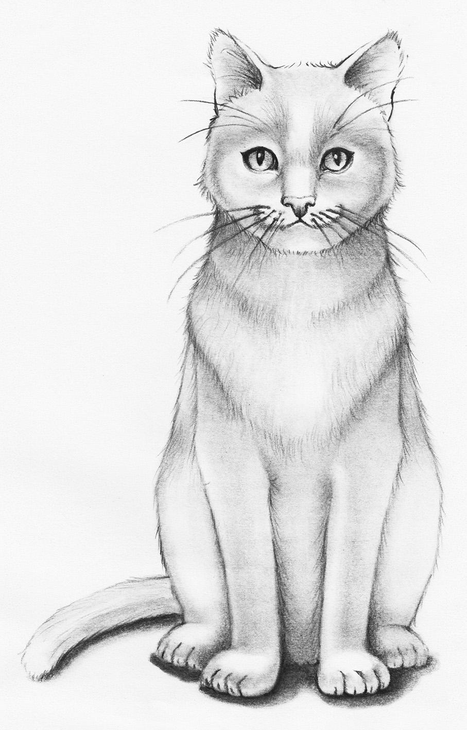
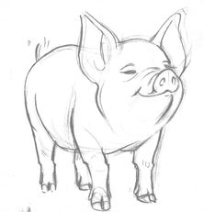
The Representation Learning Contrastive Learning
Dim 2
“Cats”
“Pigs”
Contrastive
Learning
Dim 1
“Cats”
Unlabeled Images
-1
1
“Pigs”
Page 2
Notes:
Nowaday, the pretraining finetuning paradigm is omnipresent in Natural Language and multimodality.
In pretraining, the plan is to capture the structure of the input data or a general representation of it
This representation is then used when finetuning the model on a specific tasks
One family of representation learning methods is : the contrastive learning
Let’s take a Context. We have some pictures of cats and pig. The model need to understand without labels how to contrast similar images to dissimilar ones
We want cats representation to be grouped in the embedding space and far from the rest.

Slide 3
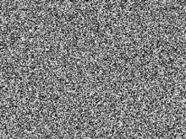
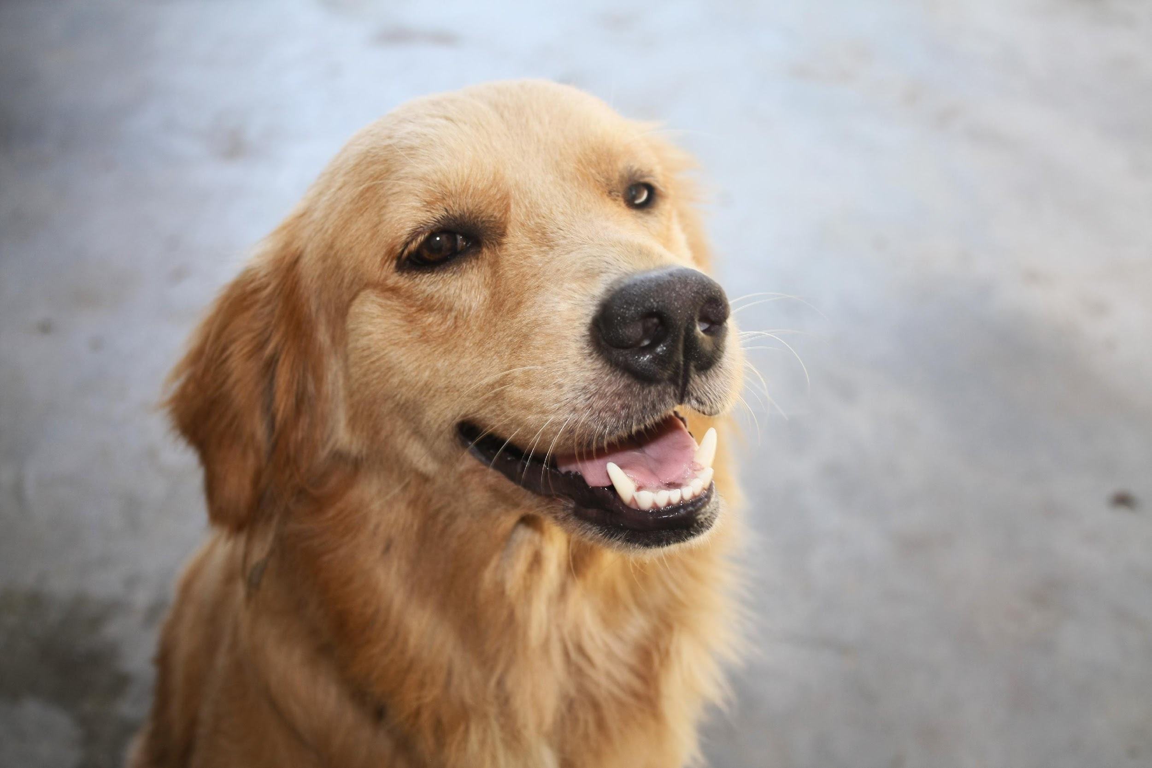
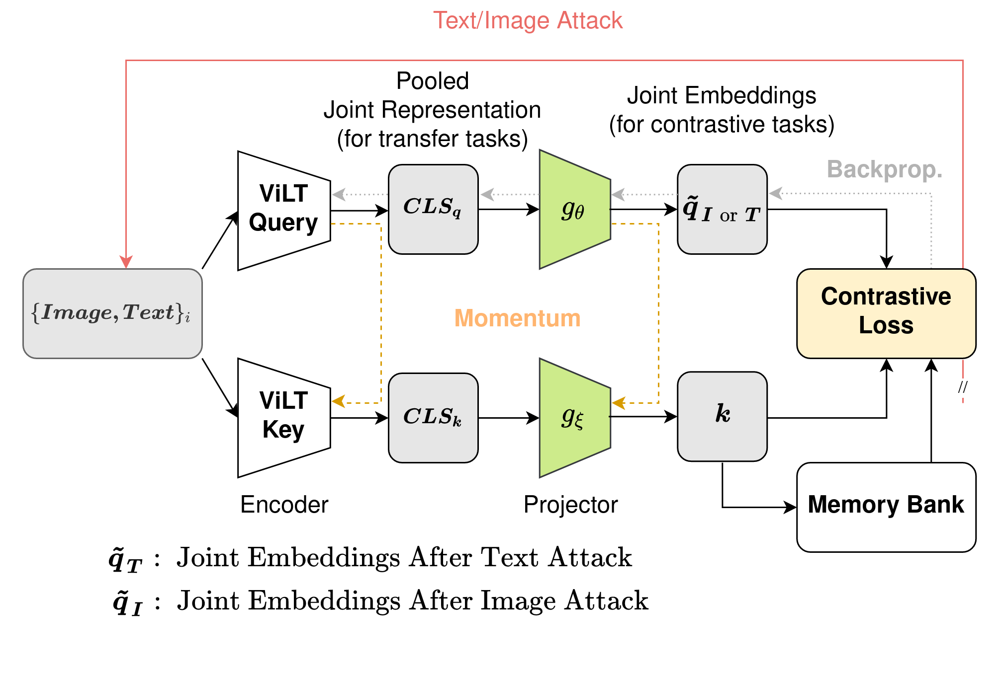
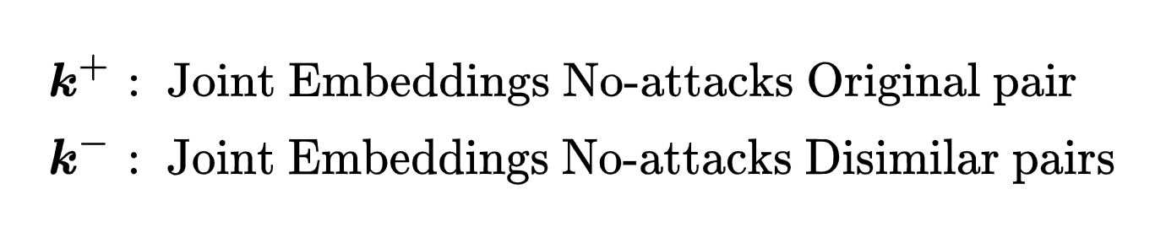
The Research Novelty
A Robust Multi-Modal Contrastive Learning RMCL
Attacked Input
Image-Text Pairs {(I_{i}, T_{i})}
Multimodal Transformer
Similar Pairs
Similar Pairs
Similar Pairs
A dog Smiling at the camera
Laughing
Dissimilar Pairs
Page 2
Notes:
I will now present our novelty: A robust Multi-Modal Contrastvbe Learning that we will call RMCL
The idea is the following :
We have image-text pair
We compute it’s joint representation k+
Then we attack only the image and compute the pair representation : qi tilde
Next we attack only the text and compute the pair representation : qt tilde
Finally all the other pairs representation are called k-
We now have Similar pairs and dissimilar pairs

Slide 4











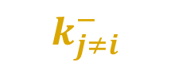

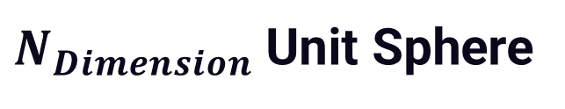
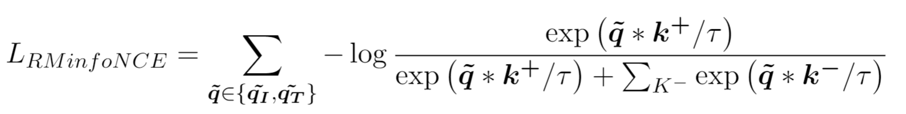
The Research Novelty
A Robust Multi-Modal Contrastive Learning RMCL
Attacked Input
Image-Text Pairs {(I_{i}, T_{i})}
Multimodal Transformer
Similar Pairs
Similar Pairs
Similar Pairs
A dog Smiling at the camera
Laughing
Dissimilar Pairs
Notes:
We assume theses N dimensional vectors to be normalized.
We represent them in a unit sphere. This is the embeddings space
We have the clean pair representation
Same representation when attacking the text
And same representation when attacking the image
And the dissimilar pair representation
Our aim is to pull together the original pair and their attacked counterpart representation. In parallel we push apart the the dissimilar pairs representation
We do so by minimizing the following loss.
This loss have two part : first We use the pair representation attacked on text secondly when attacked on the image
We want the green term : the distance between the attacked and the original pair representation to be as close as possible to 0
While we want the red term of the equation : the distance between the attacked view of the original pair and all the dissimilar pairs not attacked to be as BIG as possible
We conjecture that applying robust optimization on the multimodal contrastive loss will build a pair representation that is more robust to perturbation ans synonymously more generalized
Additionally, we hypothesis that the image and text relation within a same pair gets improved thank to the contrastive process

Slide 5
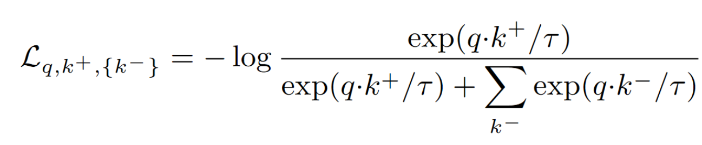
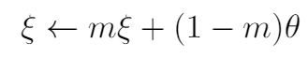
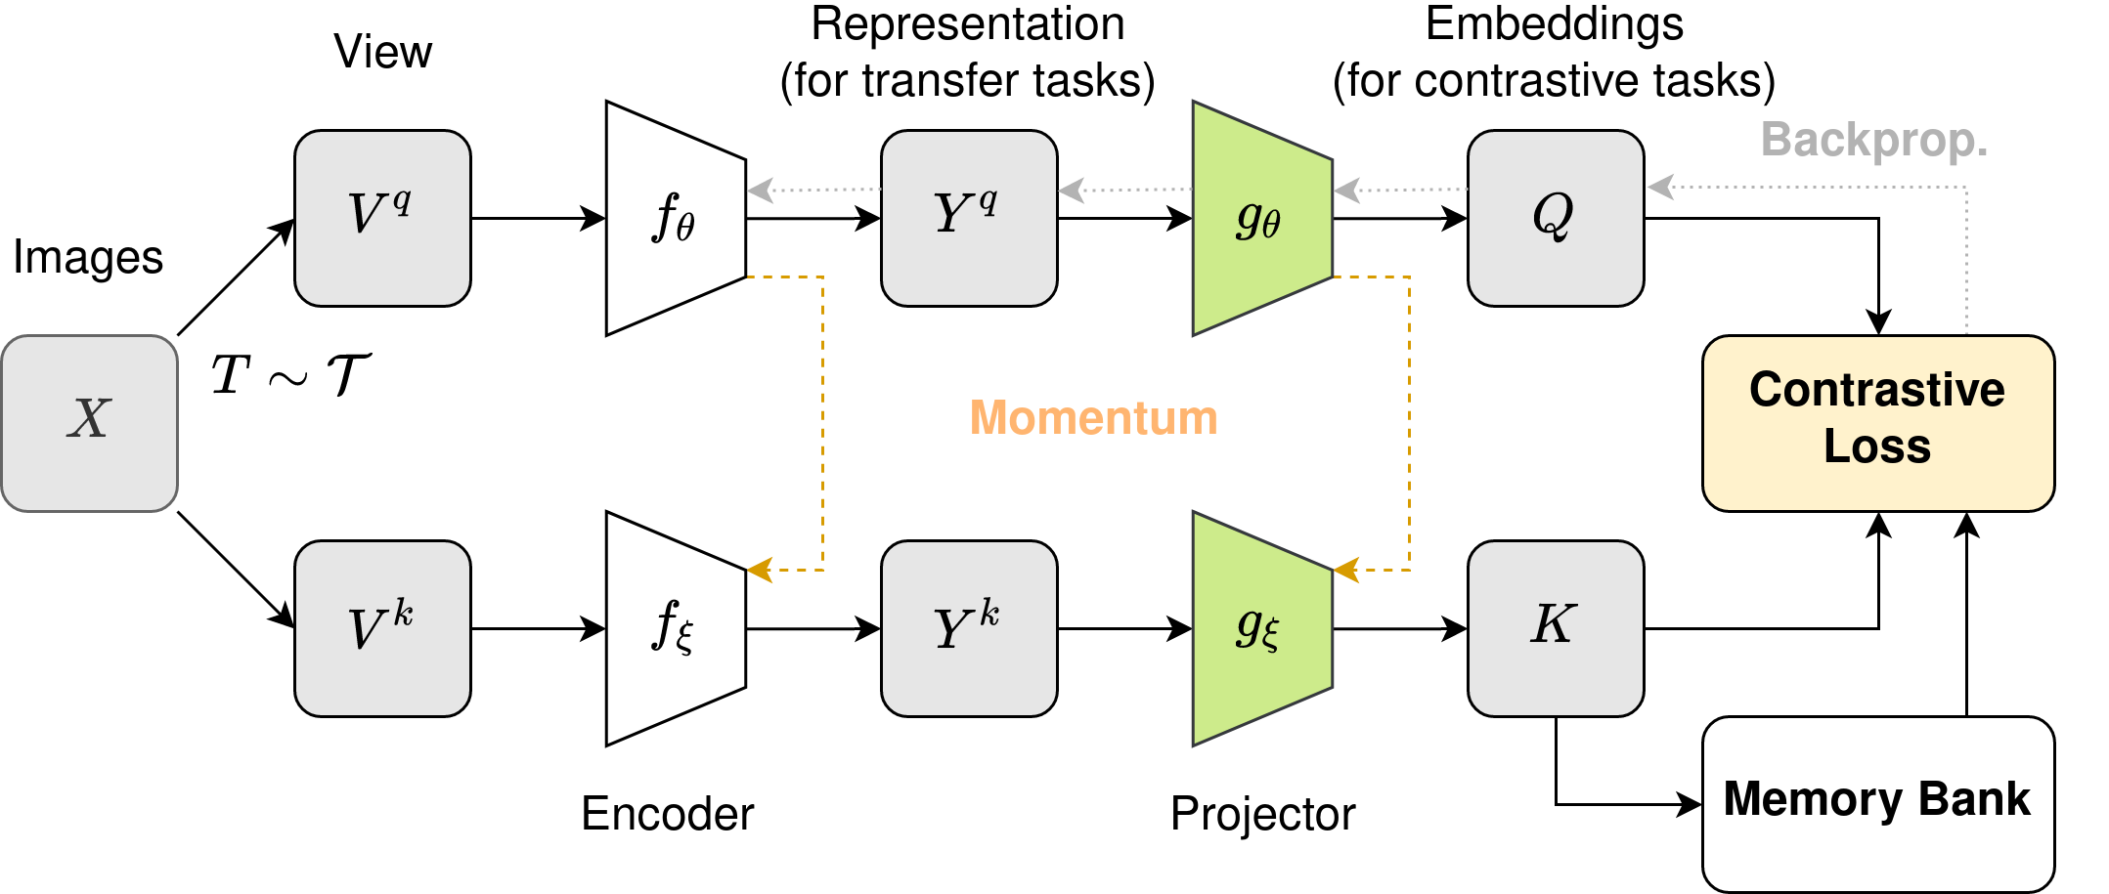
The Contrastive Frameworks MoCo
Our need : Contrastive Benefits from large batch size
The Problem : Big computing power
The Solution : Memory bank
Momentum :
[1] Chen, Xinlei, et al. "Improved baselines with momentum contrastive learning." arXiv preprint arXiv:2003.04297 (2020).[2] Shou, Y., Mamoulis, N. & Cheung, D.W.
Page 4
Notes:
our novel contrastive task is deployable on any contrastive frameworks.
We select two : MoCo and BarlowTwins
This is the standard contrastive loss thah we have seen so far
Such loss benefits from large number of dissimilar sample from a same batch
However very large batch have a prohibitive computation
The solution in moco is to keep in memory previous batches projections
Let’s clarify Moco has two branches
Each branches takes an augmented view of the original batch
It compute the representation of each augmented batch
Then it project the representation : it end up with embeddings
We save in memory the bottom batch of embeddings
And we Computing the loss
In backward pass
Updating top branch by backpropagation
Updating bottom branch by momentum on the top branch weights
The momentum update let us use a very large number of dissimilar pairs while being not heavy in computation.
Indeed, there is no backpropagation on the huge memory queue

Slide 6
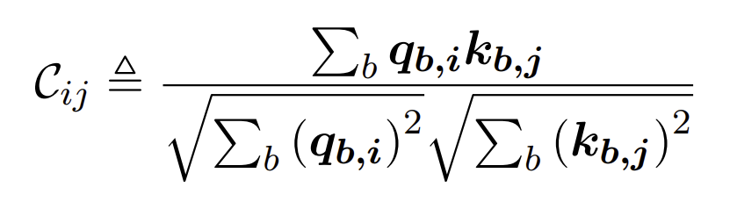
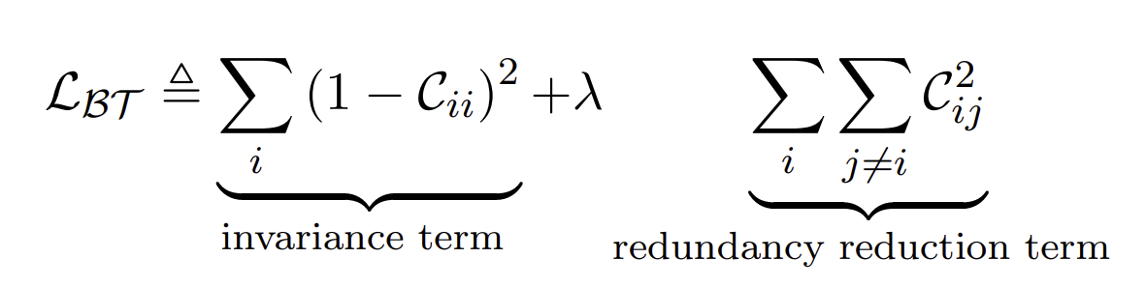
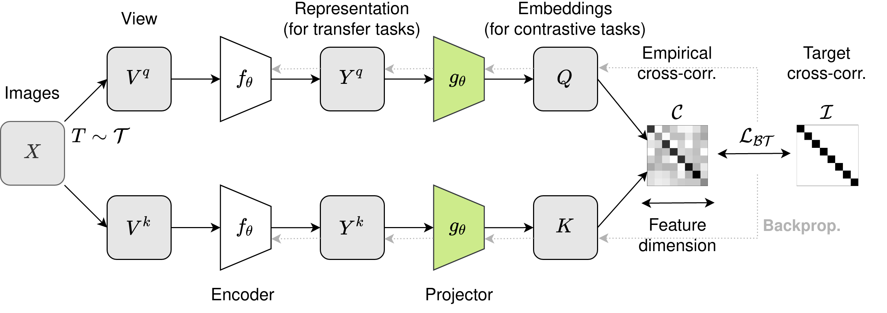
The Contrastive Frameworks BarlowTwins
MoCo Loss : It required negative pairs (Dissimilar)
BarlowTwins Loss : It DOES NOT require negative pairs
i
Share Weights
j
[2] Zbontar, Jure, et al. "Barlow twins: Self-supervised learning via redundancy reduction." arXiv preprint arXiv:2103.03230 (2021).
Page 6
Notes:
The second contrastive framework we leverage is BarlowTwins
In our MoCo loss presented : It required dissimilar pairs
BarlowTwins has introduces a loss that does not
We start with the The same structure than moco
However, now the two branches share the same weights
As before each branch have an augmented view of a same batch
Then we compute A cross-correlation matrix between output embedding.
An Element of the matrix is computed by doing the correlation between a vector of index I and index J
And the loss aim at making this cross-correlation matrix closer to the identity matrix
The first term of the loss is the diagonal element, and we want their correlation to be as close to one as possible while we want the rest of the matrix to be in correlated : egal to zero
The first term make the model invariant to transformation the second avoid redundancy
Then we compute the backpropagations on both branches

Slide 7
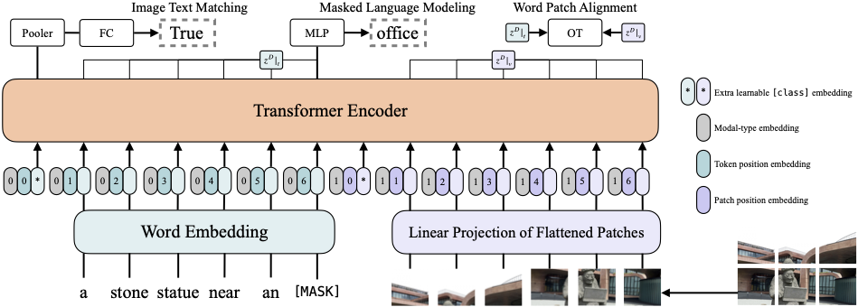
The Multimodal ViLT
Our need : Need Multimodal with fast computation
The Problem : Heavy Image features extractor
The Solution : Use Vision transformer
Pooler
CLS : Joint-Representation
[3] Kim, Wonjae, Bokyung Son, and Ildoo Kim. "Vilt: Vision-and-language transformer without convolution or region supervision." arXiv preprint arXiv:2102.03334 (2021).
Page 5
Notes:
Now we select our multimodal encoder. And wfor that we defined our need :
Our need is a multimodal with fast computation
However most Vision & language model use heavy image features extractor
VilT not, it uses vision transformer
Let’s see:
We have an image-text pair
We devided the image into patches or token
We compute compute the embedding for each token with a Linear projector and concatenate with their relative position
We add two special token
The left one is the class token of the pairs
We use the first output of the transformer, our special token and feed a pooler
Finally we get our Joint-Representation of the image text pair

Slide 8
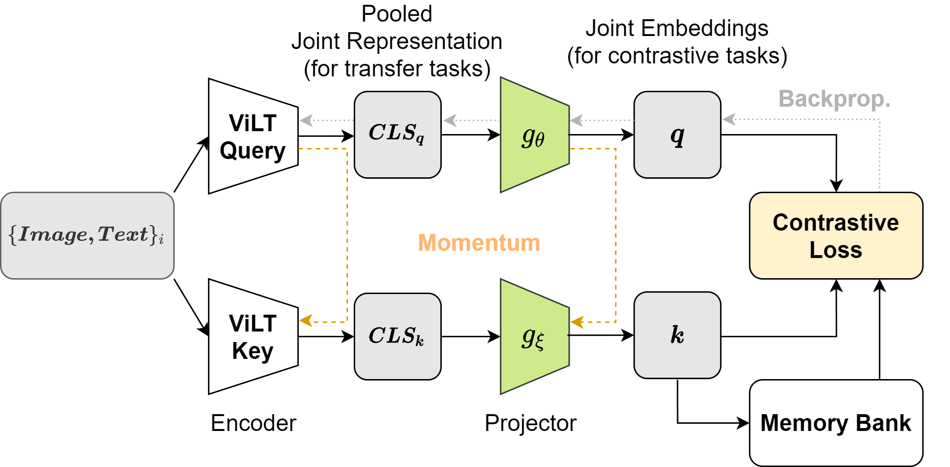
The Robust Multi Modal Framework
Image attacks
/ Text attacks
Page 6
Notes:
Let’s see the full framework of our Robust Multi Modal contrastive task
We represent only MoCo, but the same hold for BarlowTwins
This is the MoCo structure with a ViLT multimodal encoder
In forward pass
We Feed the top and bottom ViLT with same batch of pairs
Then We get a Joint representation.
That we feed to the projector and get the joint embedding
Here comes the robust part :
We iteratively attack the loss on first the Image and get qi and then the text and get qt
Now we compute the loss
Next We save the bottom branch representation in memory
and do the Bachaward pass
Update top branch with backpropagation
And bottom branch with momentum update

Slide 9
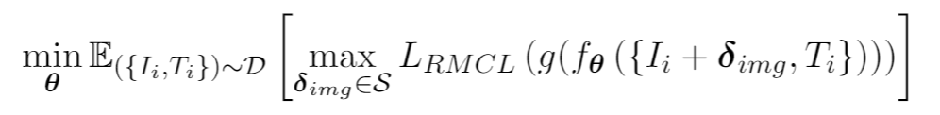
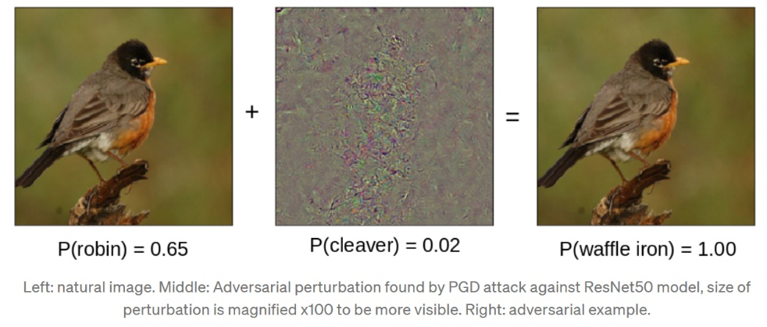
The Attacks PGD [Image]
Key Idea : Find the perturbation that maximizes the loss by following the sign of the gradient
Result : PGD is the “ultimate” first-order adversary for Image
Robustness against the PGD adversary yields robustness against all first-order adversaries
The Saddle Point Problem :
Inner Maximization problem:
[4] Madry, Aleksander, et al. "Towards deep learning models resistant to adversarial attacks." arXiv preprint arXiv:1706.06083 (2017).
Page 7
Notes:
Let’s see the attacks.
For the Image we use the PGD attack
Key Idea : Find the perturbation that maximizes the loss by following the sign of the gradient
Result : PGD is the “ultimate” first-order adversary for Image
Robustness to PGD yields robustness against all first-order adversaries
It’s a saddle point problem. A model wants to minimize the Loss while the attack wants to maximize the loss
The Inner Maximization solution is the PGD following equation
We have the image then the perturbation compute by following the positive direction of the gradient

Slide 10
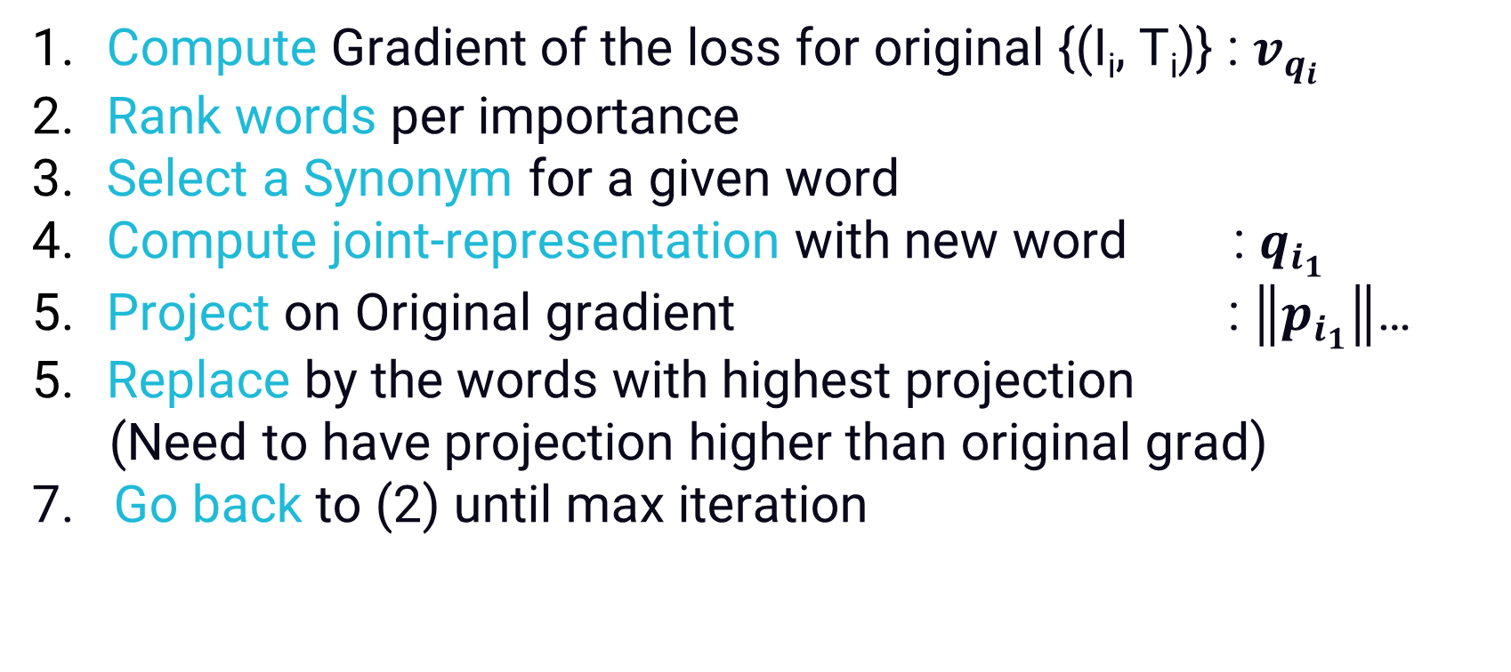
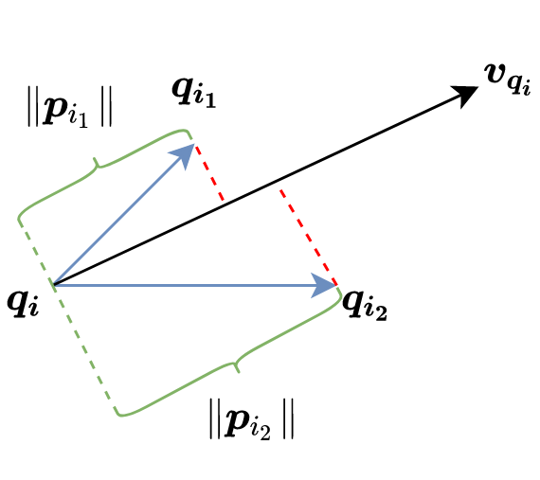
The Attacks Geometric Inspired [Text]
Key Idea : Generates adversarials by efficient word replacement
Two steps : word selection and synonym replacement
Result : Fool model with high success and low word replacement
[5] Meng, Zhao, and Roger Wattenhofer. "A Geometry-Inspired Attack for Generating Natural Language Adversarial Examples." arXiv preprint arXiv:2010.01345 (2020).
Page 8
Notes:
For Text we use the Geometric inspired attack
Key Idea : Generates adversarial examples by an efficient words replacement
It’s two steps : word selection and synonym replacement
Result : It Fools natural language model with high success and lower word replacement rate
Let’s see how it works :
Compute Gradient of the loss for original pair
Rank words of sentence per importance
Select a Synonym set for a given word
Compute pair-representation with new word
Project this vector on Original gradient
Choose words with greatest projection
Go back to (2) until max iteration

Slide 11
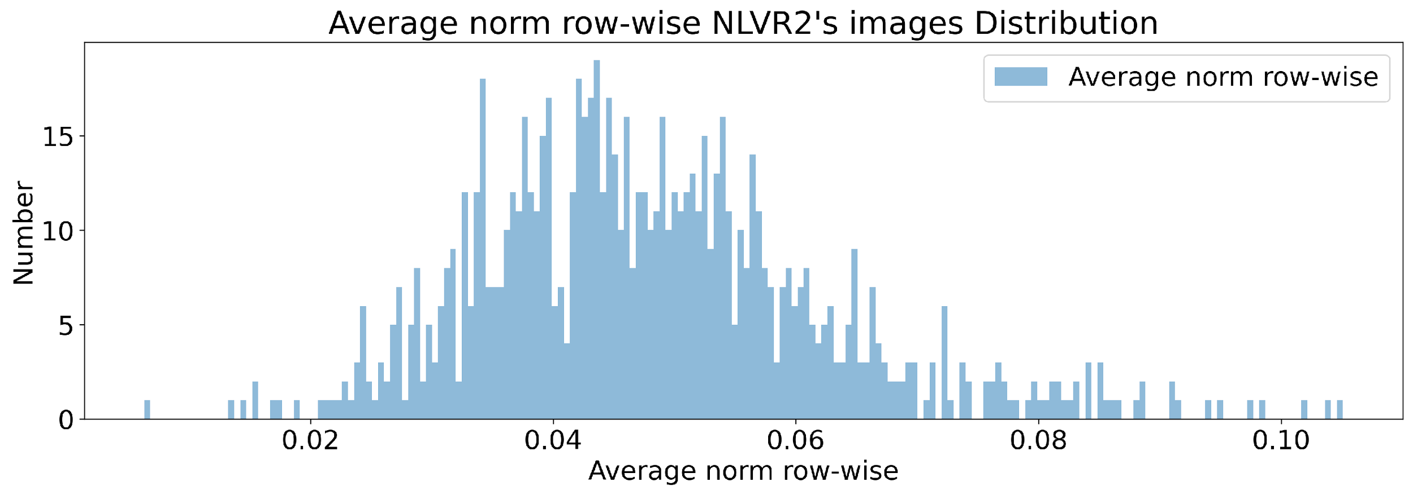
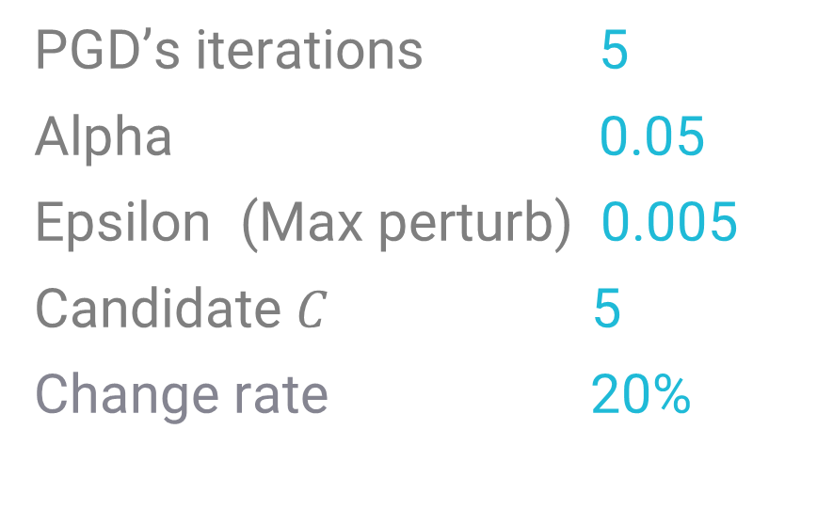
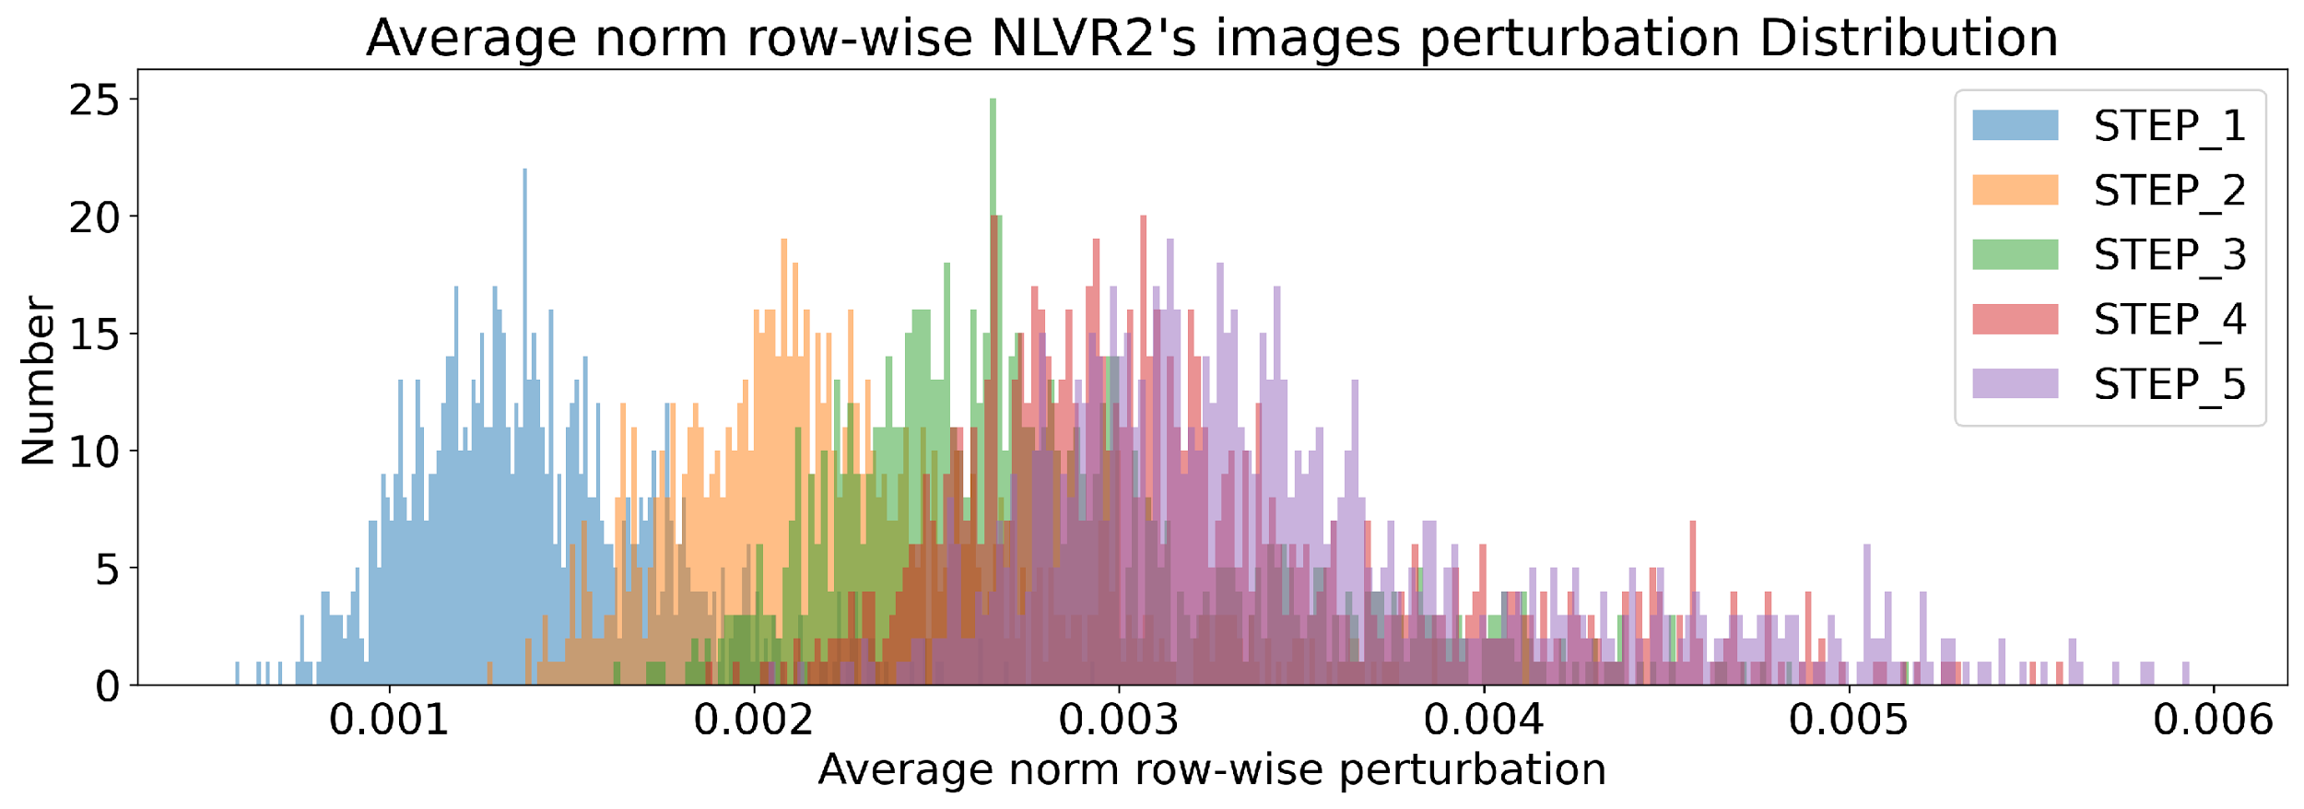
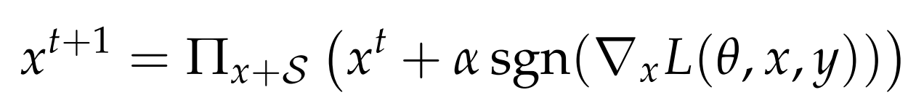
The Results Adversaries’ hyperparameters
Hyperparameter.
PGD [Images]
=0.05
<0.005
Original ViLT Accuracy : 74.8 %
After PGD :10.4 %
After Geometric : 35.4 %
Page 9
Notes:
Now we present the different results of the methodologie:
First we select the adversaries ’hyperparameters by analyzing the attacks impact on the cross-entropy loss
We select the following hyperparameters.
For the PGD we use 5 iteration , an attack learning rate of 0.05 and a max perturbation per dimension of 0.005.
To put in context, We plot the average norm of image from a given dataset
The norm of the images are included between 0.02 and 0.08
Then, we display the norm of the added perturbation. The norm is an order of magnitude smaller
For the Text attack, we select 5 as max number of synonym candidate per chosen words
We select a maximum change rate of 20% per sentence.
In term of Accuracy; The original ViLT accuracy on NLVR2 is 74 % when after PGD attack it drops to 10.4% and after Geometric attacks it drops to 35 %

Slide 12
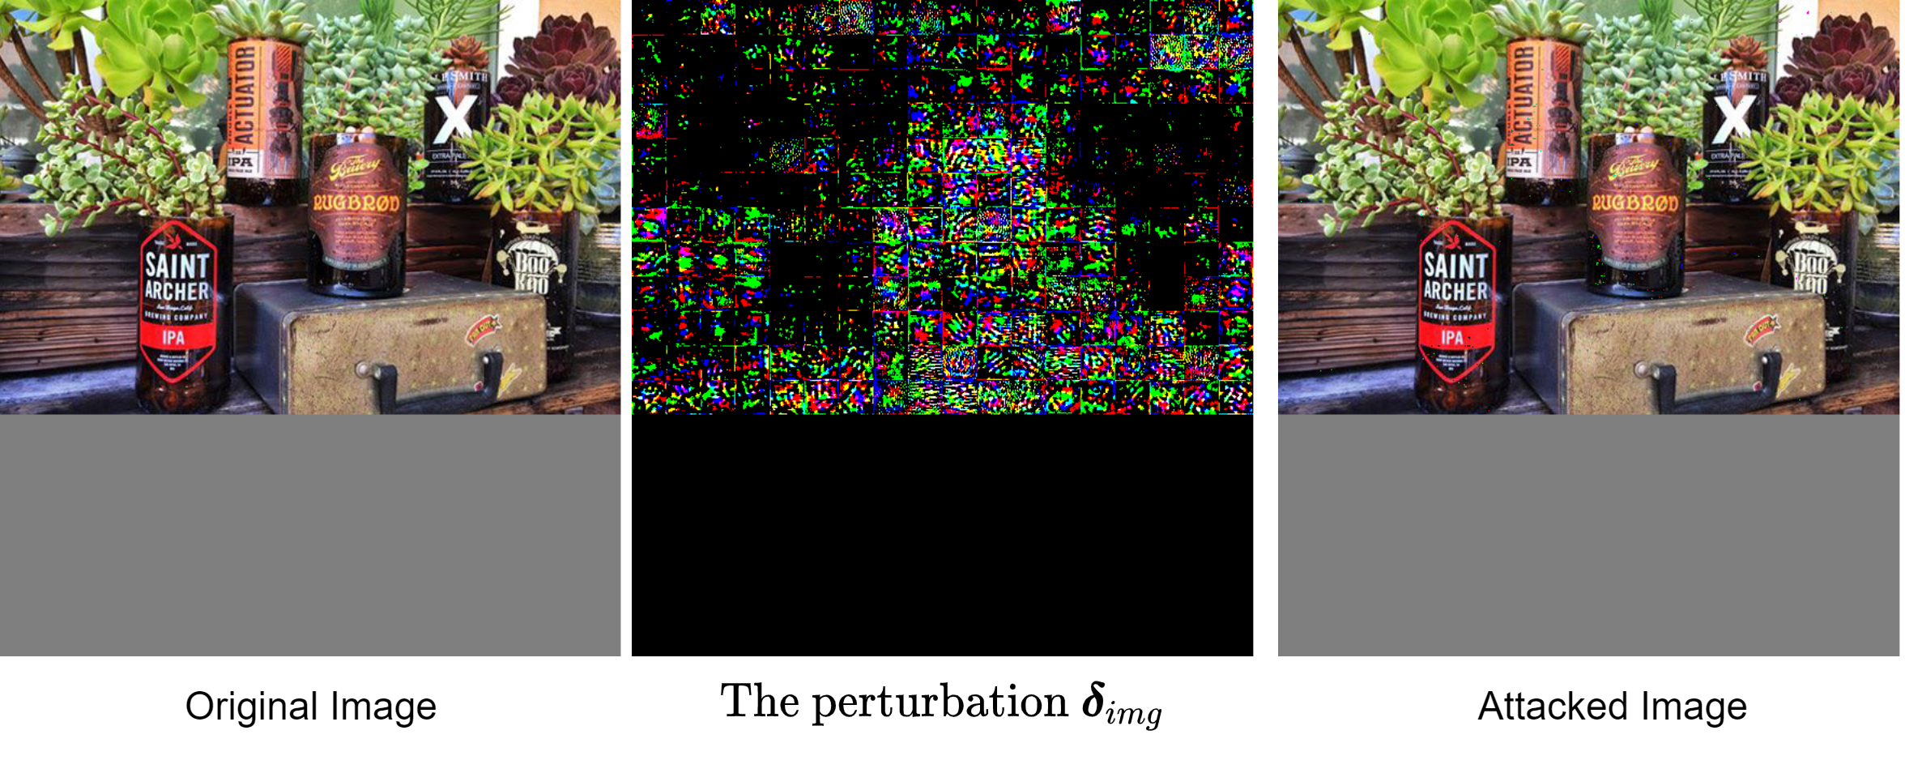
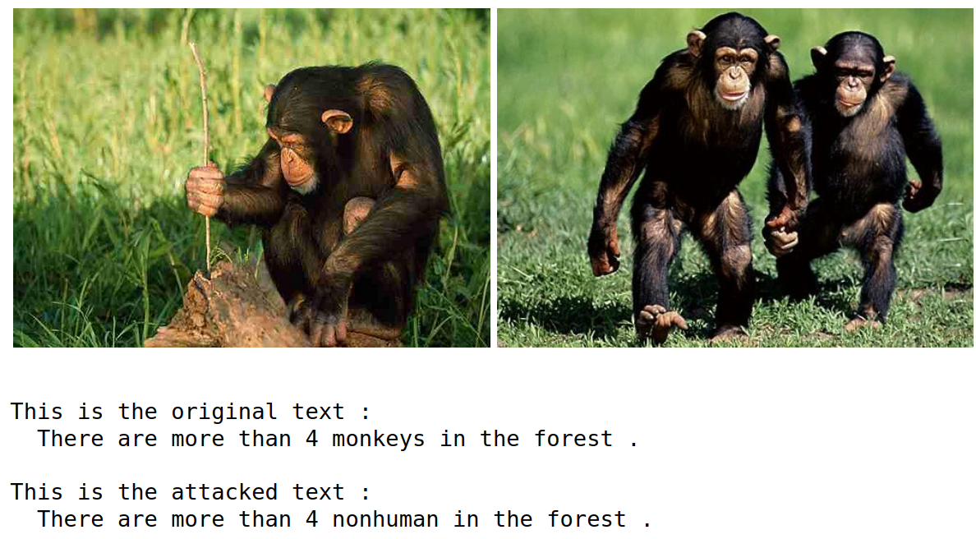
The Results Attacked Samples
Page 10
Notes:
Let’s display adversarial exemples with our parameters.
On the left the original image on the middle the perturbation and on the right the attacked images
We observe almost not Corruption on the image while almost all the pixels are attacked
For Geometric attacks.
The top line is the original text : there are more than 4 monkeys in the forest
And the bottom is the attacked :
The word monkey have been replaced by nonhuman.
As we can see the adversaries have strong impact on accuracy while being almost imperceptible.

Slide 13
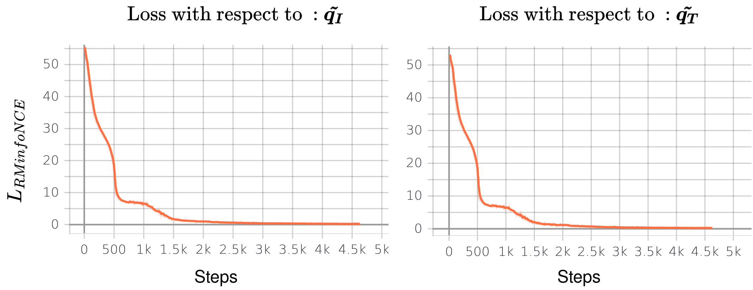
The Results Pretraining MoCo
Pretraining with RMCL : 1 epoch on only COCO dataset
Page 11
Notes:
The parameters are selected, let’s look at the pretraining.
For pretraining with use only COCO dataset and trained for a single Epoch.
This plot shows the two part of our loss. On the left With respect to the image attacked pair and on the Right with respect to geometric attacked pair representation
Both terms of the loss have decreased significantly and in the same way.

Slide 14
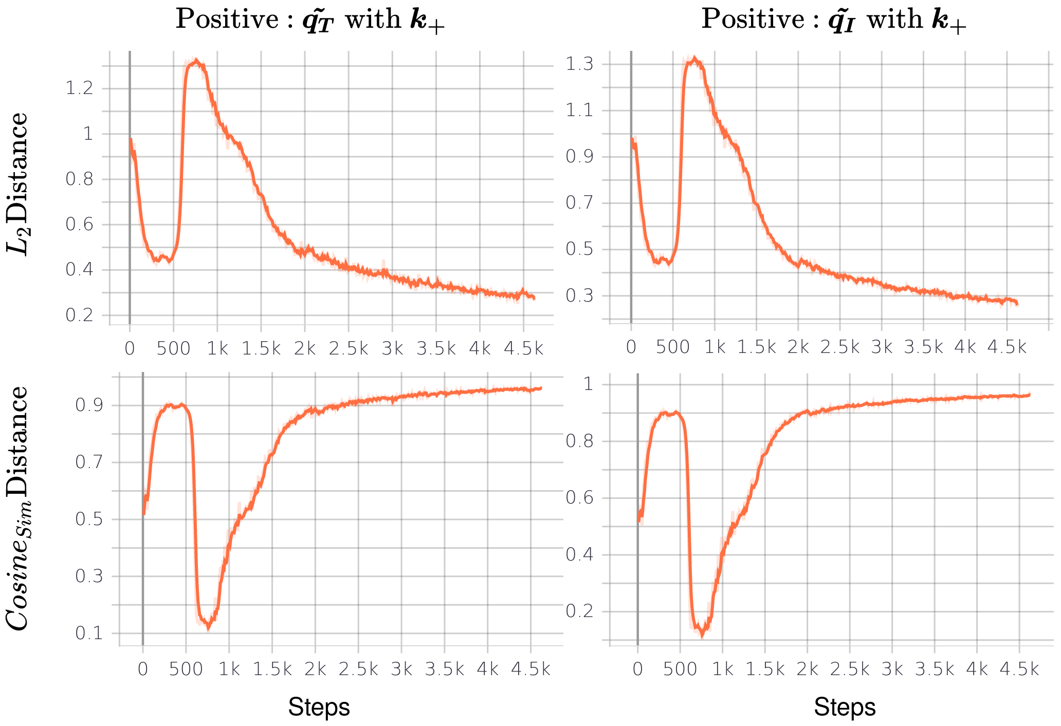






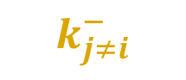




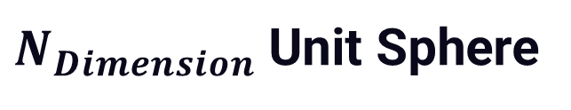
The Results Pretraining MoCo
Page 12
Notes:
Now let’s see our aims of pulling and pushing representation vectors
This plot shows the positive distance: Positive means between a clean pair representation and the same pair but attacked and the negative are all the other dissimilar pairs representations
The distances are in term of the l2norm top row and the cosine similarity bottom row. The attacked text is on the left and attacked image pairs representation on the right
In both cases : the l2 distance is decreasing
While the cosine similarity is converging to 1
This is as expected : The original pair representation and it’s attacked counterpart are pulled together
The overshooting in these figures comes from the random initialized memory queue in MoCo
We argue that the training process start for real around 1k steps when the queue is filled with pairs representations

Slide 15
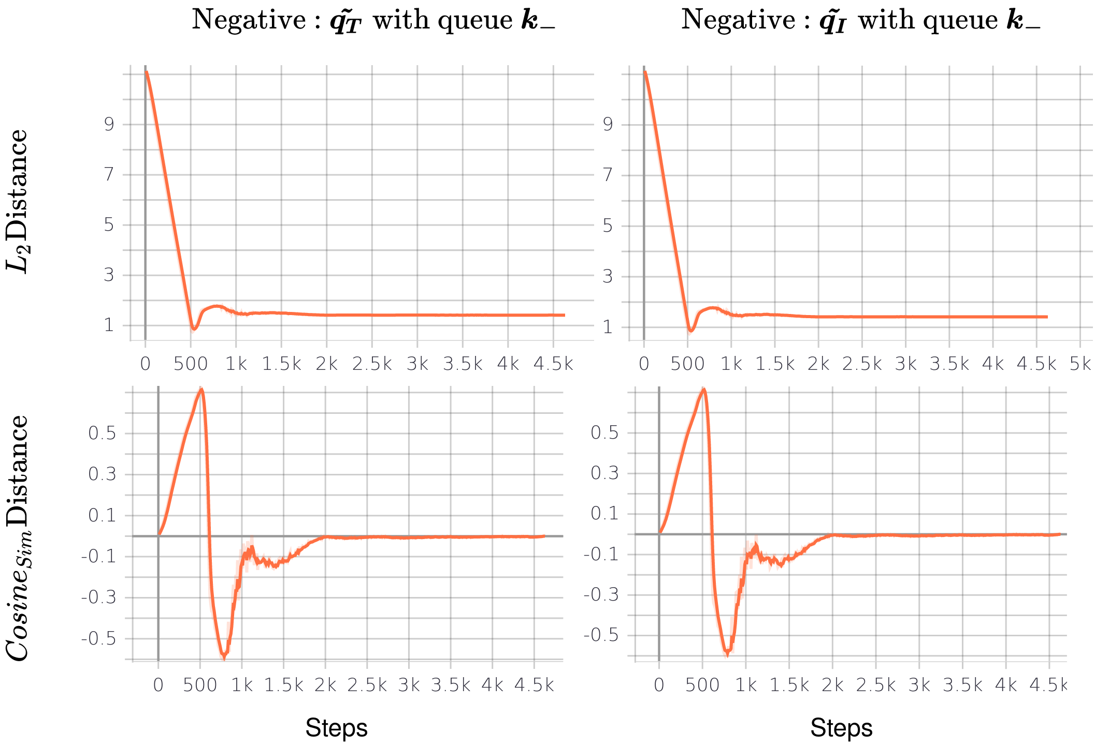
The Results Pretraining MoCo
Page 13
Notes:
Now same graph but for the distances with the negative pairs: in other words : the distance between an attacked pair and dissimilar pairs representation
Same as before : top is l2norm bottom is cosine similarity left is attacked text right is attacked image representation
The distance in term of l2 norm is slightly increasing if we look at after the overshooting
The cosine is converging to 0 : Thus, the positive and negative pairs are orthogonal in the embeddings space.
Our target of pushing apart the dissimilar pairs seems achieved

Slide 16
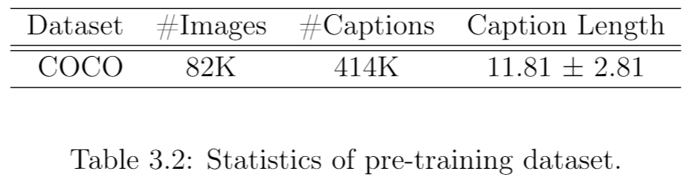
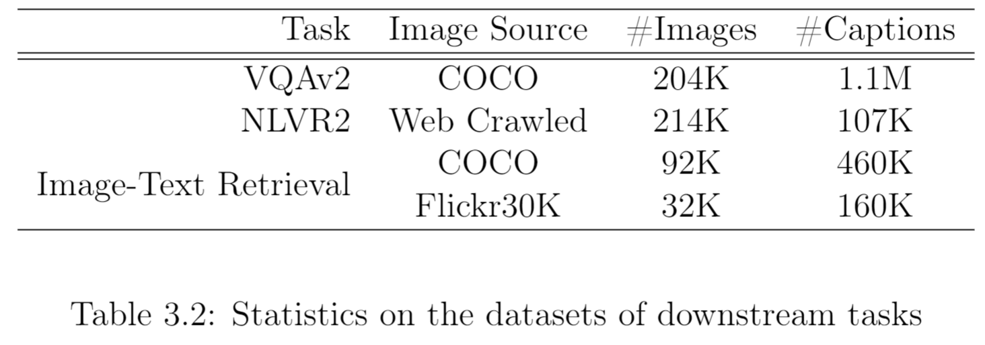
The Results Robustness evaluation MoCo / BarlowTwins
Pretraining with RMCL : 1 epoch on only COCO dataset
Page 14
Notes:
We look now at the performance of ViLT pretrained with our RMCL methods.
We pretrained our model for 1 epoch on COCO dataset only.
We finetune on two classification tasks : VQA an in-domain dataset : It means with the same dataset than pretraining
and NLVR2 an out-of-domain dataset : It means with different dataset than pretraining
And we finetune on image text-retrieval on In domain and out of domain datasets.
The size of our pretrained dataset is not bigger than the size of the downstream tasks.

Slide 17
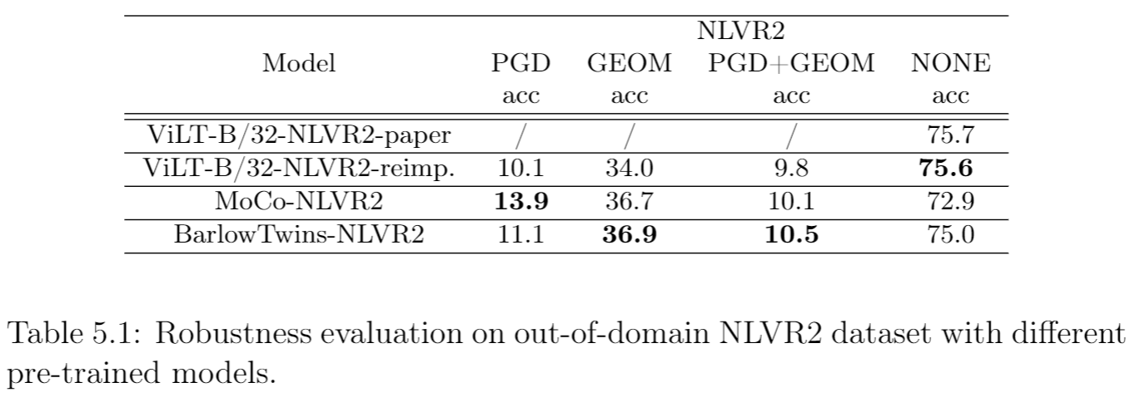
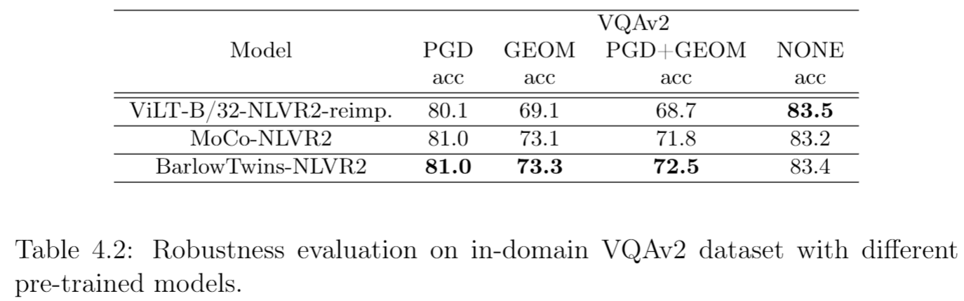
The Results Robustness evaluation MoCo / BarlowTwins
Pretraining with RMCL : 1 epoch on only COCO dataset
Out-of-Domain
+3.8 %
+2.9 %
+0.7 %
-0.6 %
In-Domain
+0.9 %
+4.2 %
+3.8 %
-0.1 %
Page 15
Notes:
Here is the results on the robustness evaluation.
We conduct 4 experrience.:
We attack only the image
Then only the text
Then both modality one by one
And finally we do no attacks at all
The first row represent the paper accuracy
The second is our reimplementation.
The third and the fourth are ViLT further pretrained with our methods and finetuned on NLVR2
We observed that both our methods leads stronger performance against these attacks. Indeed we have + 4% of improvement on PGD +3% on Geom and almost +1% on both attacks
We have the same types of result for VQA an indomain dataset. Once again our methods leads stronger performance against theses attacked :
Amost +1% against PGD, +4% against Geom and +3.8% against both attacked.
Considering having pretrained for a single epoch on COCO dataset these results are encouraging.
Now if we look at the accuracy without attack our models gets slightly weaker. Indeed, it’s know that robust optimization enhance the generalization of the model at the cost of specific accuracy performance dropes.
However, the drop isn’t that that significant

Slide 18
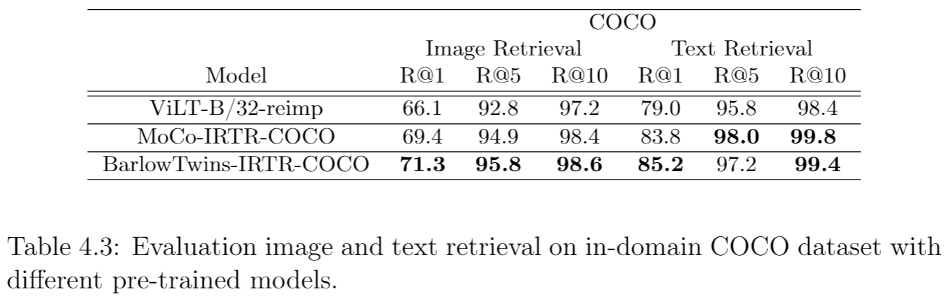
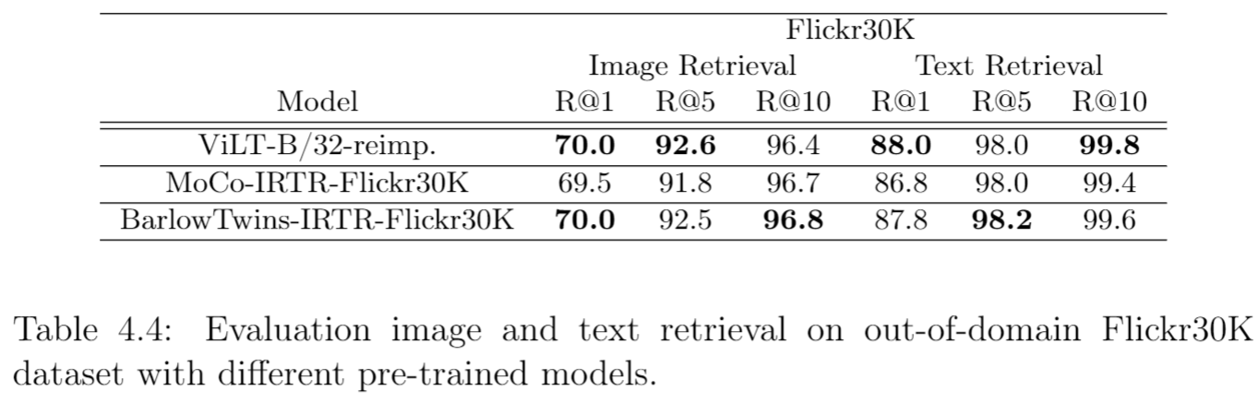
The Results Evaluation MoCo / BarlowTwins
Pretraining with RMCL : 1 epoch on only COCO dataset
In-Domain
+5.2 %
+3.0 %
+1.4 %
+6.2 %
+2.2 %
+0.2 %
Out-of-Domain
+0 %
-0.1 %
+0.2 %
-0.2 %
+0.2 %
-0.2 %
Page 16
Notes:
This is the results on the image-text retrieval tasks.
We start with the retrieval on COCO.
In image retrieval for exemple : Given an image text pair, we generate 15 negative pairs by replacing in the original pair the image with random ones
Recovery 1 : Means the solution is in the highest predicted score
Recovery 5 : means the solution is in the 5th highest predicted score
And so on for
Recovery 10
We observe a strong improvement on this tasks with our methods.
Indeed we gain in average 3% of every recovery column.
Now we have the same plot but for the out-of domain Flickr30k
This time our methods didn’t get weaker or stronger. The results are similar between with and without our methods.
Once again, we hypothesize that a single epoch on only COCO is not enough to improve generalization beyond the in-domain datasets.
Anyway, the overall results of these slide are again very encouraging.

Slide 19
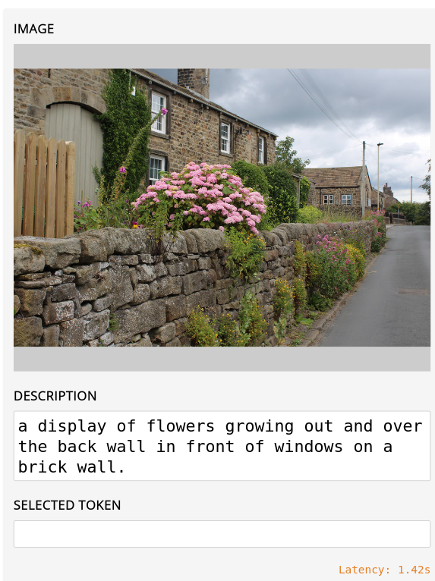
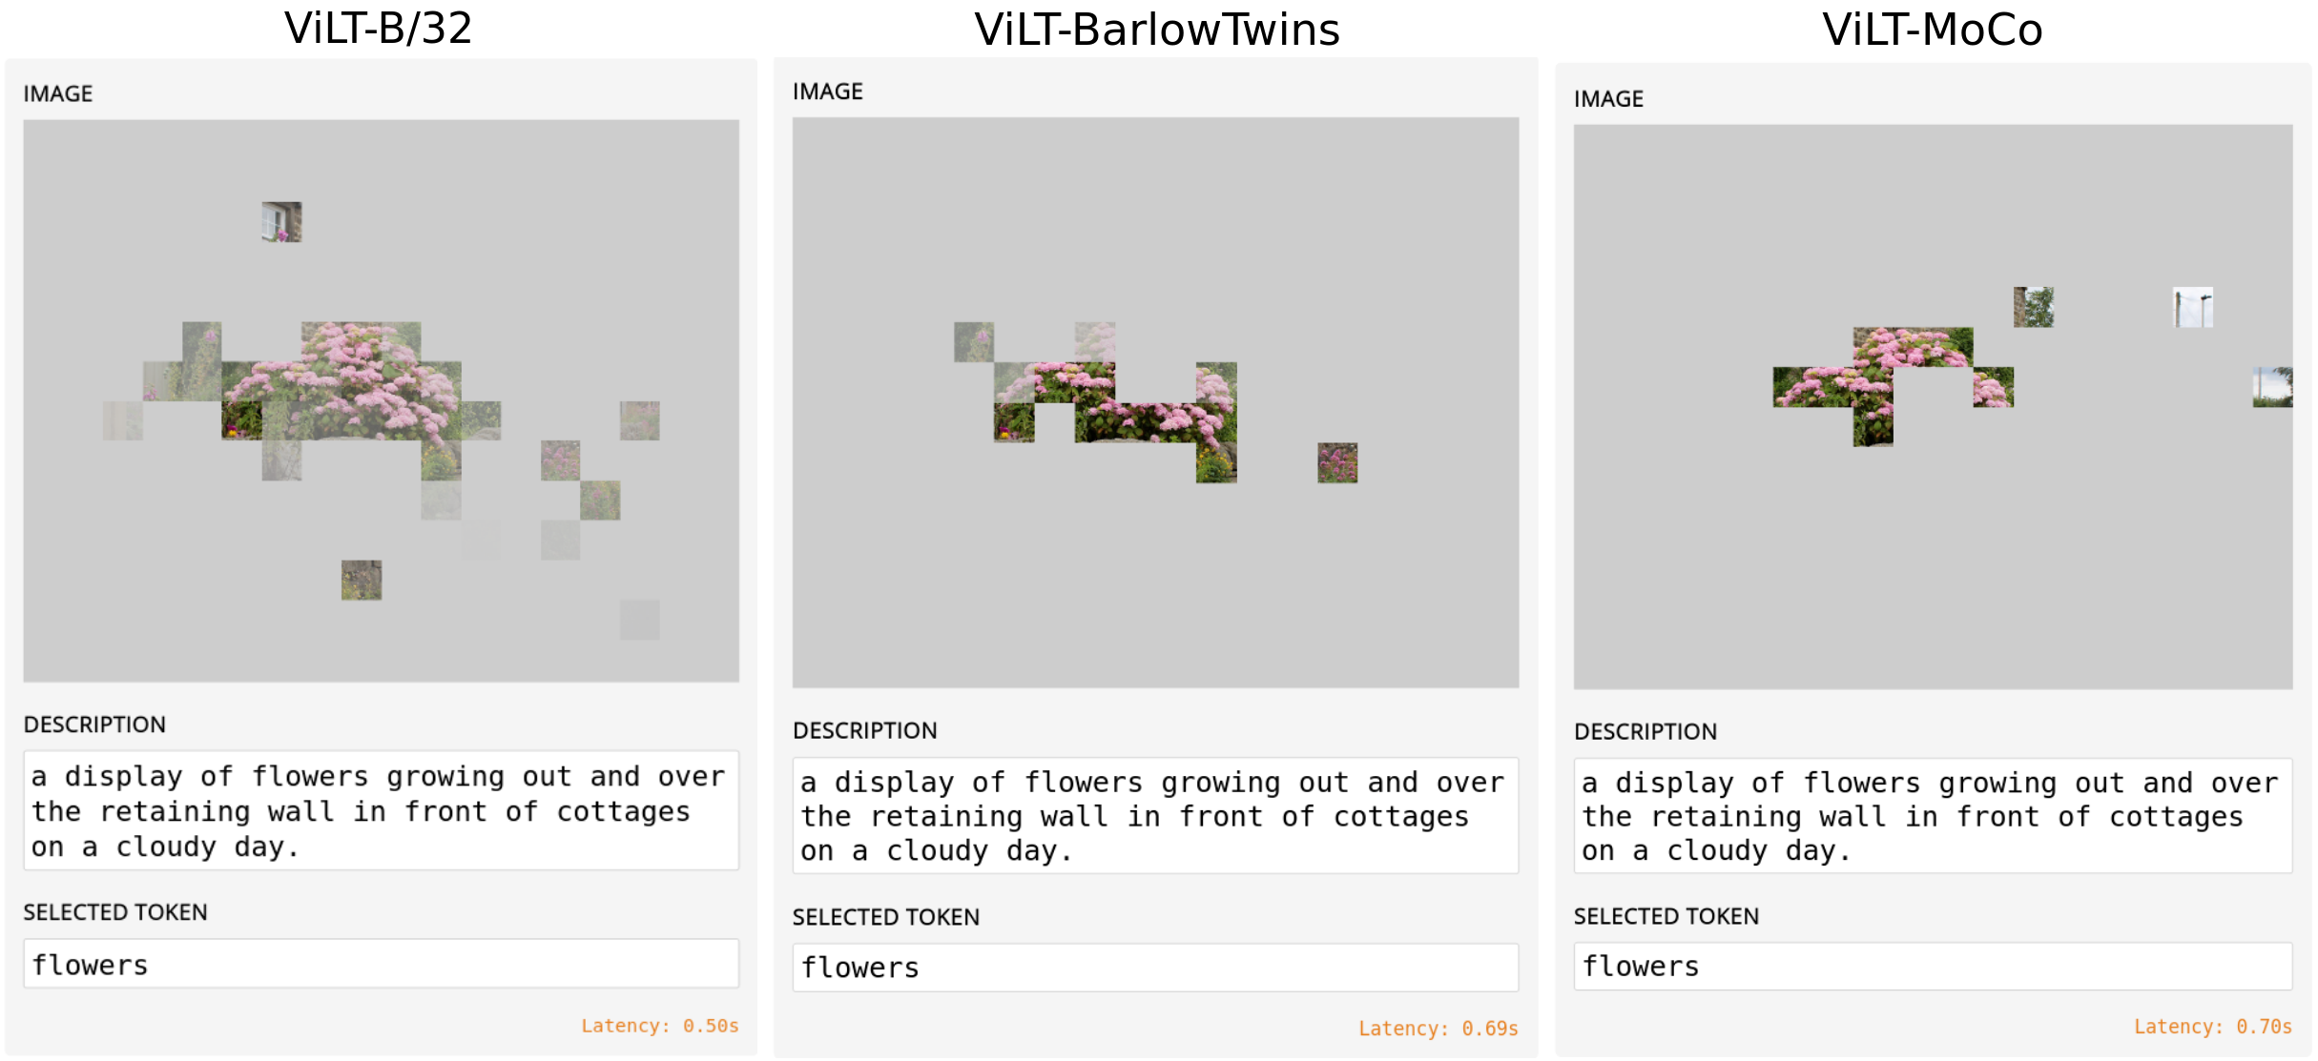
The Results Modality Alignement MoCo / BarlowTwins
Pretraining with RMCL : 1 epoch on only COCO dataset
Page 17
Notes:
Finally we looked at the modality alignment
On the left we have an image text pairs.
We select a token : for exemple flowers and we plot the words to patch alignment heatmap.
Each square represents a patch, and its opacity indicates how much the patch is related to the highlighted word token.
On the left we have the original ViLT on the middle barlowtwins and on the Right MoCo.
Our method enhance the words-to-patch alignment. Although, both BarlowTwins and MoCo loses informations, they makes the alignment more opac and synonymiously enhance the image-text relation.

Slide 20
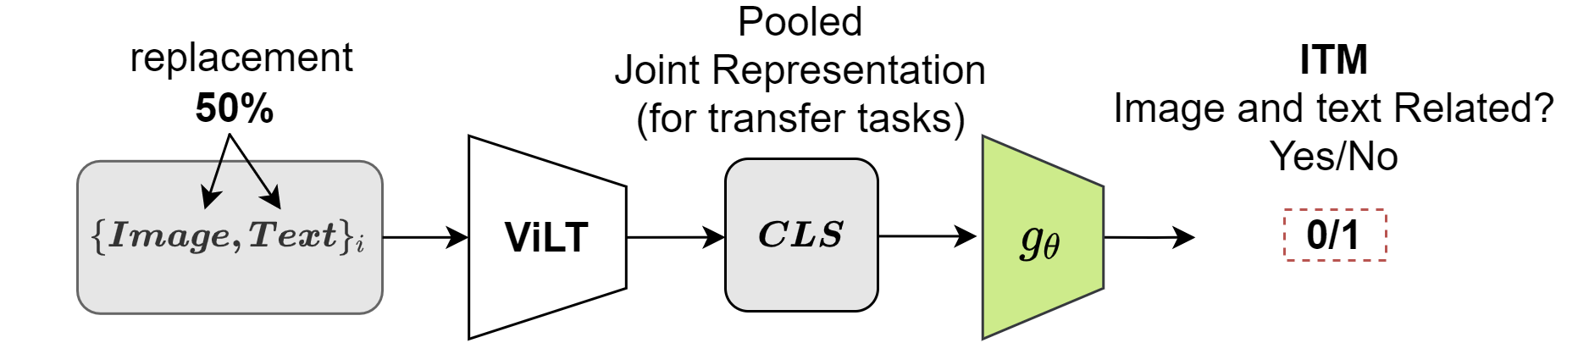
The Future works
Pretrained on CoCo - SBU – Visual Caption – Conceptual caption on 10 epochs
In parallel, Examined the uses of stronger and synonymous more perceptible adversaries.
Explore the benefits of doing ITM pretraining after having done RMCL
Page 18
Notes:
Now that we have done a proof of concept, it is time to indicate the future of the works in the view of a very soon publication:
Indeed, all the code is ready now we need to pretrained on a larger dataset coco-sbu-vg-conceptual caption on at least 10 epochs.
We increased the pretraining by an order of magnitude.
In parallel we could think about the uses of stronger and synonymously more perceptible adversaries. Indeed, contrastive loss benefits from strong augmentation, at the condition that the semantic meaning is not lost.
Finally, we may explore the benefits of doing an Image Text Matching pretraining tasks after having done the RMCL

Slide 21
thank you.
Notes:
Thank you all for your attention

